Slide 1
Attendance Automation using Face Recognition
Vasu Arora
Section-C
Roll No-67

Slide 2
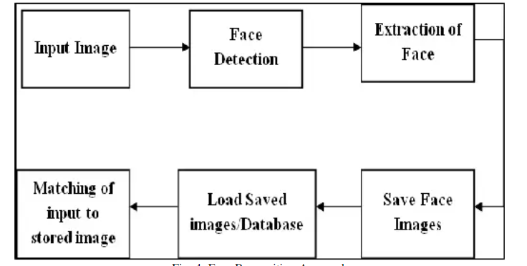
Introduction What is Face Recognition?
• Face detection attendance system detects the facial expressions of employees and marks attendance.
Why Face Recognition?
• Efficiency: Reduces the time and effort required for manual tracking.
• Accuracy: Face recognition systems can achieve high accuracy in identifying individuals.
• Traditional Challenge: Reducing the possibility of proxies.

Slide 3
Literature Survey Key Steps
Face Detection: The system needs to be able to locate and identify faces in images or video frames.
Face Recognition: Once faces are detected, the system must compare and match them against a database of known individuals.
Attendance Logging: When a match is found, the system registers the individual as present with his name, time in a file.

Slide 4

Methodology Steps to Build a Face Recognition System
Step 1: Install libraries:
• face_recognition: Built-in Python library used for detecting or confirming the identity of individuals based on facial images.
• Opencv for some image pre-processing for face recognition tasks.
• Tkinter is a Python library that can be used to construct basic graphical user interface (GUI) applications.
• Tk stands for toolkit and was developed as the GUI library.
• The os.path module in Python helps in working with file paths and perform various operations related to file.

Slide 5
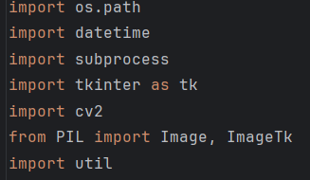

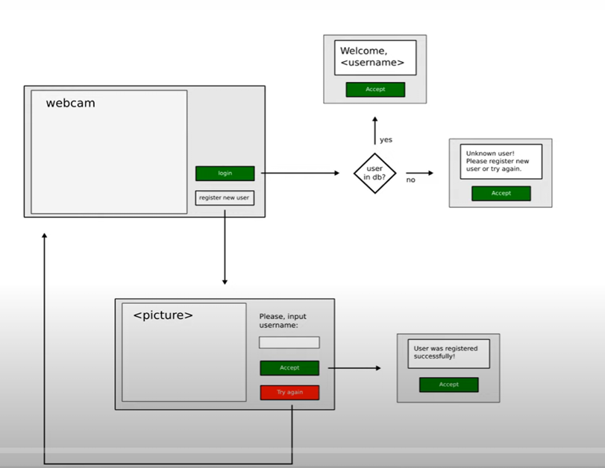
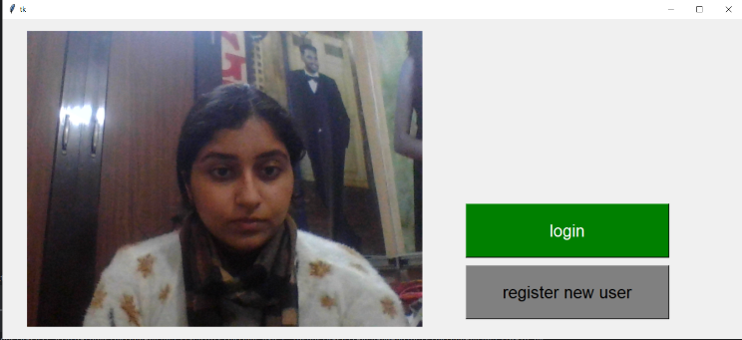
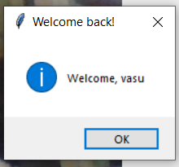

Step 2: Import libraries
Step 3:User Interface: The system should
have a user-friendly interface.

Slide 6
Step 4: Capture the frames
This line of code initializes the camera for capturing frames.
# Initialize the camera
cap = cv2.VideoCapture(0)
The argument "0" specifies that the default camera should be used. If you have multiple cameras connected to your computer, you can change this value to select a different camera.

Slide 7
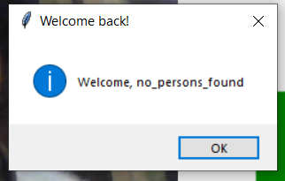
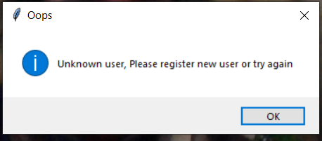
Step 5:Attendance File Creation
• Create a file to store the attendance with time.
Step 6:Face Matching and Attendance Marking
• Compute face embeddings for the detected faces.
• Compare the computed embeddings with the embeddings of known individuals.
• If a match is found, mark the attendance for that person.

Slide 8
Result and Discussion
Face of the person will be detected and recognised when the person is logging in. If match is found , attendance is marked else not.
For registering new users, their face will be detected and image will be saved in a file.
When no person is found, a pop up will be displayed.

Slide 9
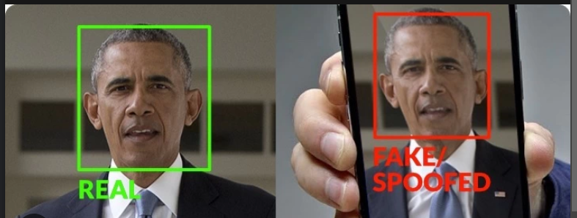
Conclusion and Future Work
Face recognition systems can reduce manual work and time and are more accurate.
Time and Accuracy can be increased.
Fake and real face distinction can be made by adding Anti Spoofing Model features.

